Slide 1
Intro to R
Or, “How I Learned to Stop Worrying and Love the R”
Jacob Steele

Slide 2

Background
First learning about R/Programming…
Videos/examples could feel overwhelming
Don’t know the language
Couldn’t think of practical applications
Felt like people had memorized every command
Felt discouraged and held back from utilizing programming as a tool!

Slide 3


Why give this talk?
Very excited when I heard about the R Users Group
Those unfamiliar could feel uncomfortable or intimidated
Wanted to “bridge the gap” for newcomers and ease any doubts

Slide 4
My background
I am not an expert.
Background in molecular biology
Graduated w/ Bachelor’s in Biology in 2016 (A-State)
Only started learning about programming in 2017
With limited exposure before then, felt I could be an “audience surrogate”
“I’ve been there. This is how I made it easier.”

Slide 5

Presentation Summary
Overview of key points for getting started, becoming familiar
RStudio Setup
Navigating RStudio
How to use R as a beginner
Additional Learning Resources

Slide 6
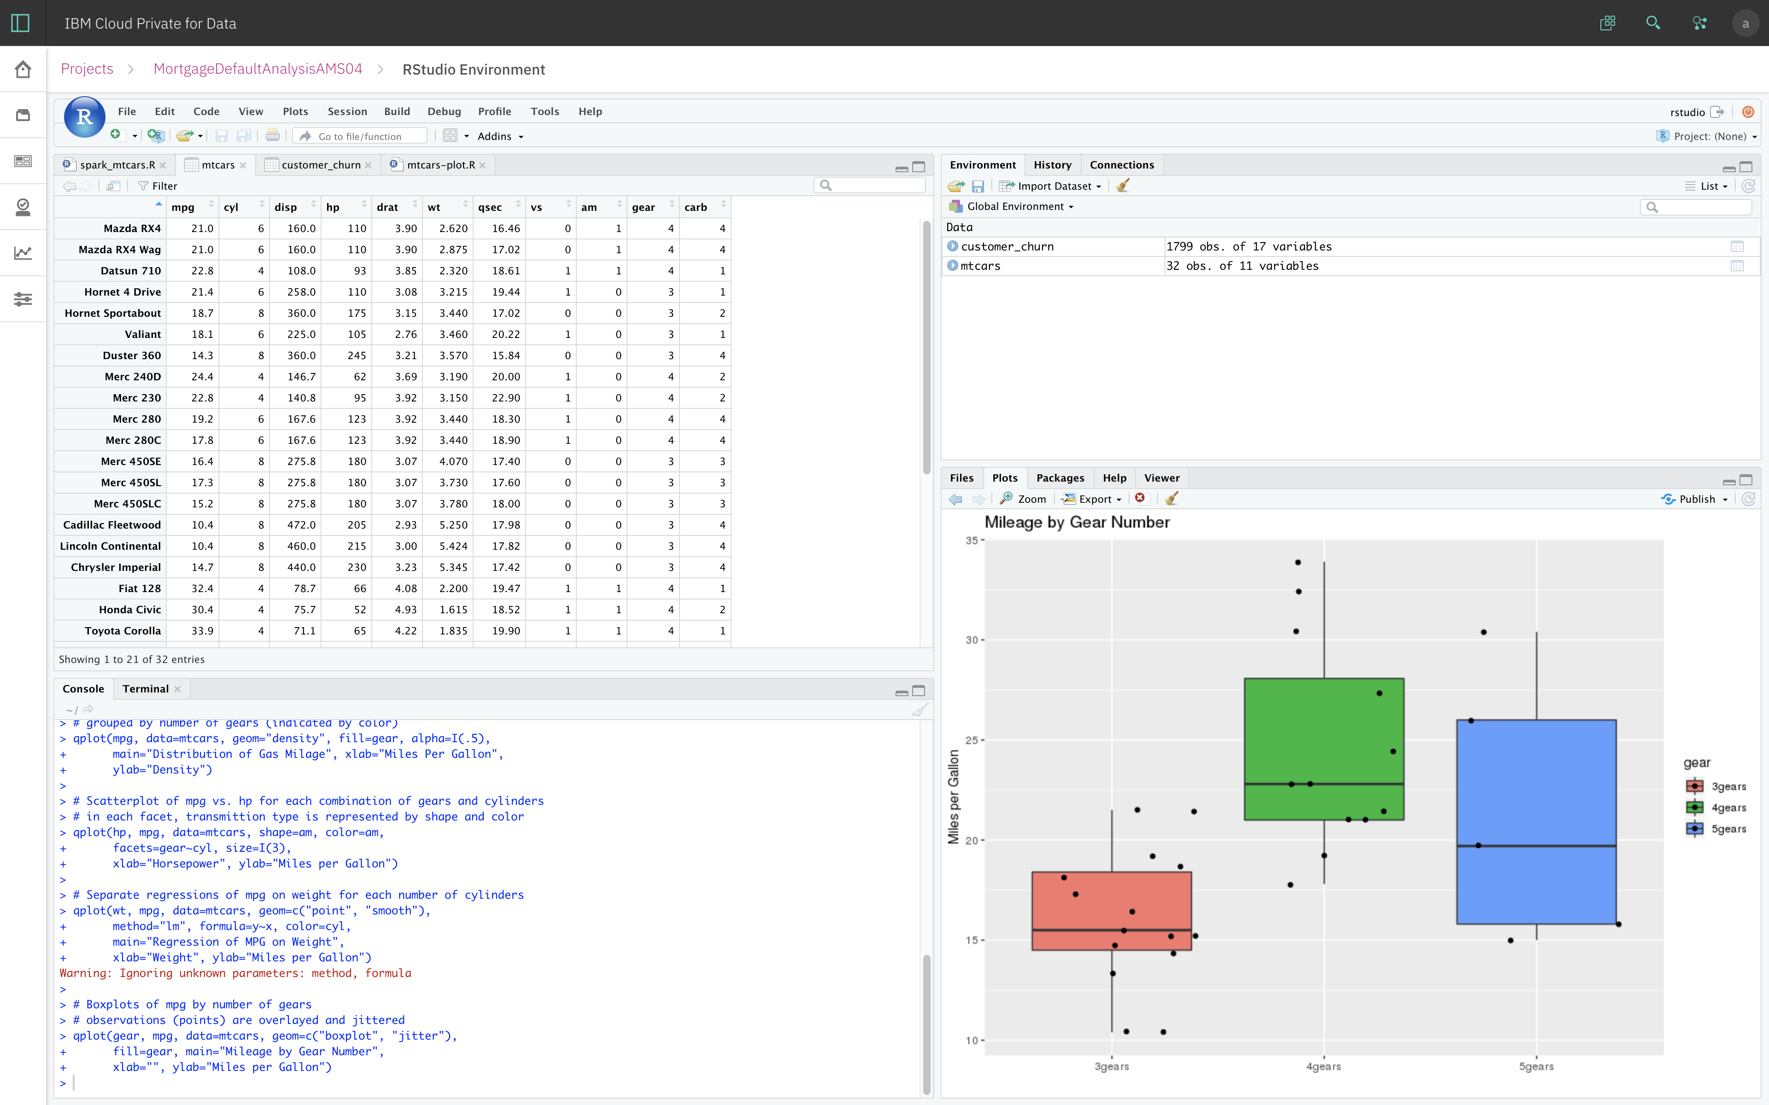
Why use Rstudio?
RStudio helped make R much more friendly to newcomers
Easy-to-understand interface that helps keep track of and preview your variables, etc.
Can really customize to fit your needs

Slide 7
Rstudio Setup
To get RStudio up-and-running, need to proceed through two steps…
First, need to install R itself
(The base engine to run R scripts/programs)
Then, can install R Studio
(How we will be interacting with the R language)

Slide 8
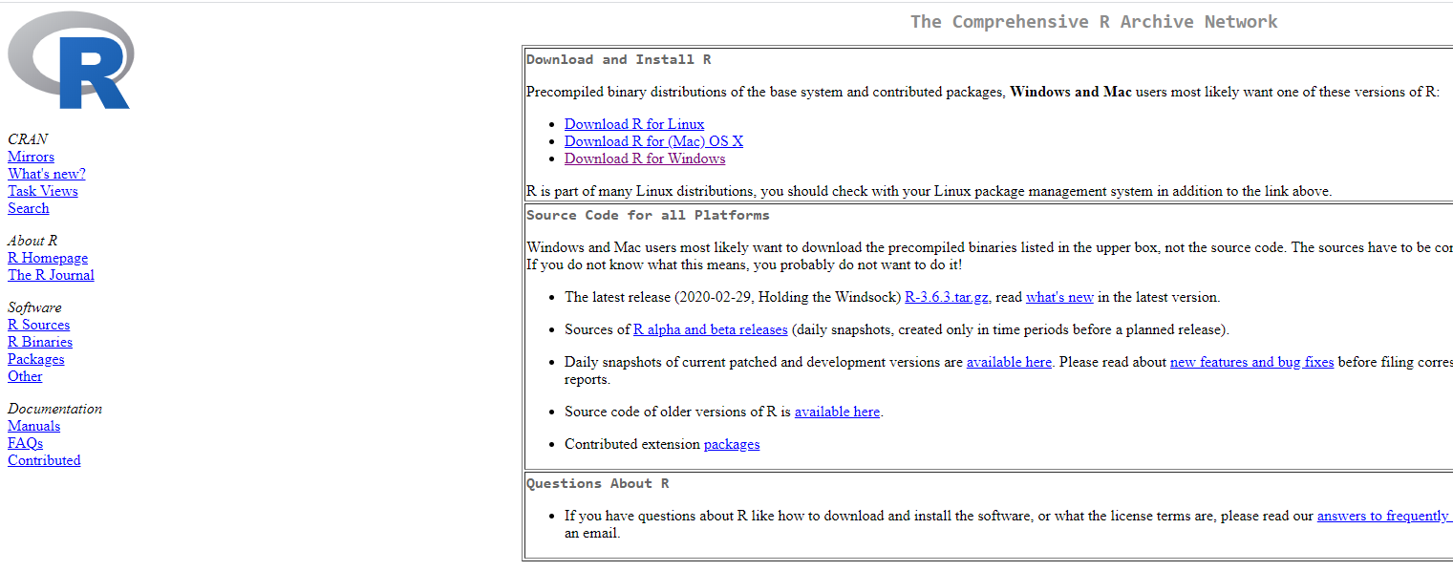
Installing R
Download R for your machine from https://cran.rstudio.com

Slide 9
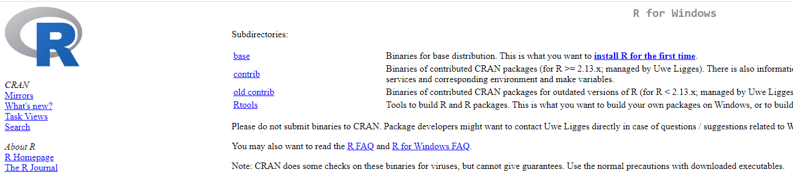
Installing R
Select “base”

Slide 10
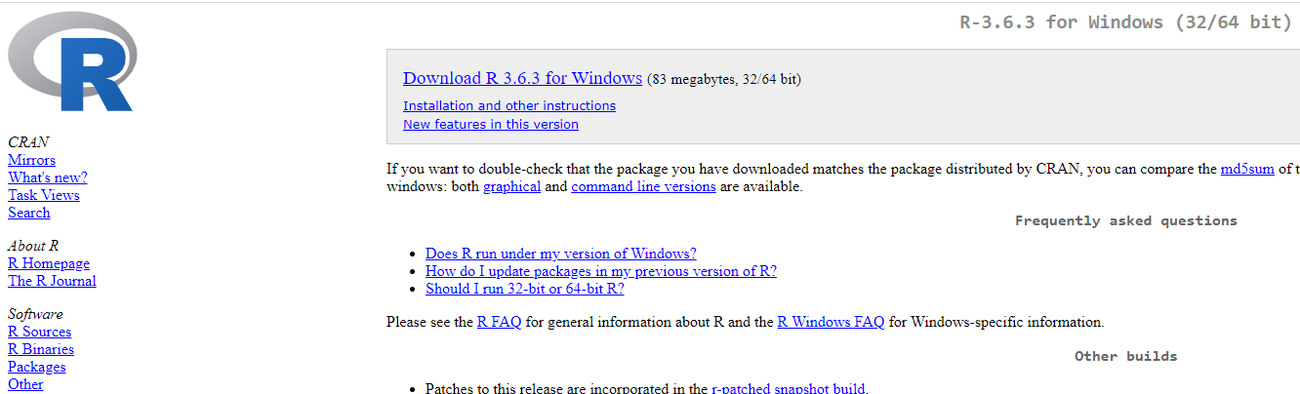
Installing R
Select “Download”

Slide 11
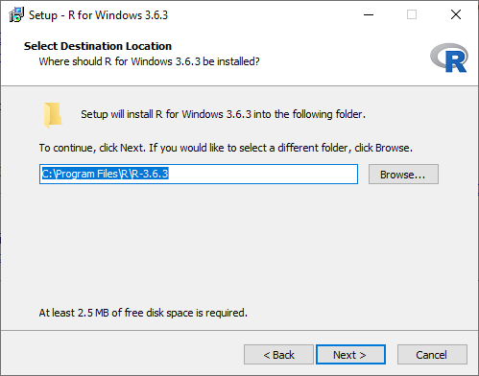
Installing R
Proceed through installer… (I suggest no desktop shortcut)

Slide 12
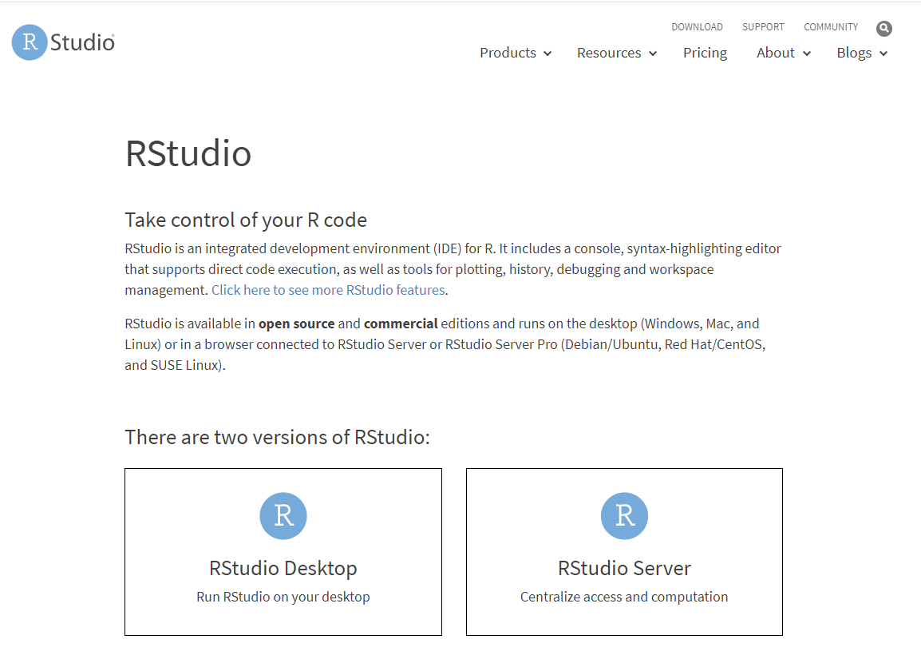
Installing R STUDIO
Download R Studio Desktop “Open Source Edition” from https://rstudio.com/products/rstudio/

Slide 13
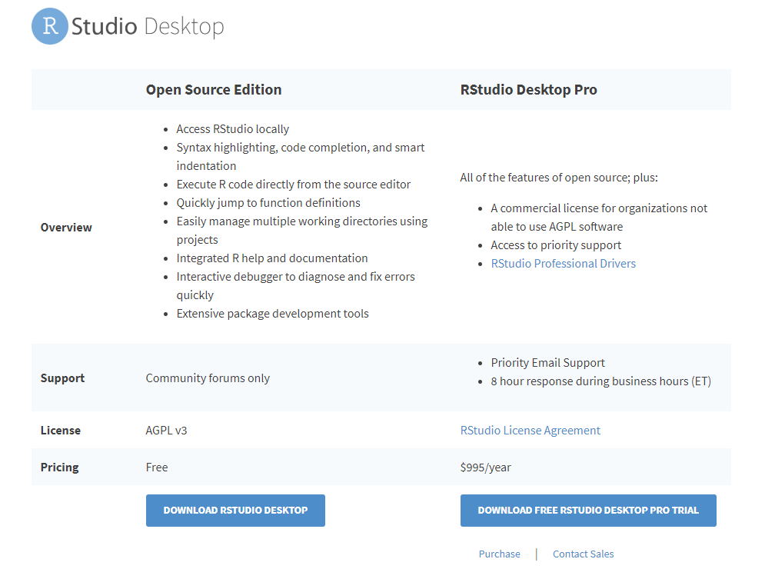
Installing R STUDIO
Select “Download RStudio Desktop” in the “Open Source Edition” column

Slide 14
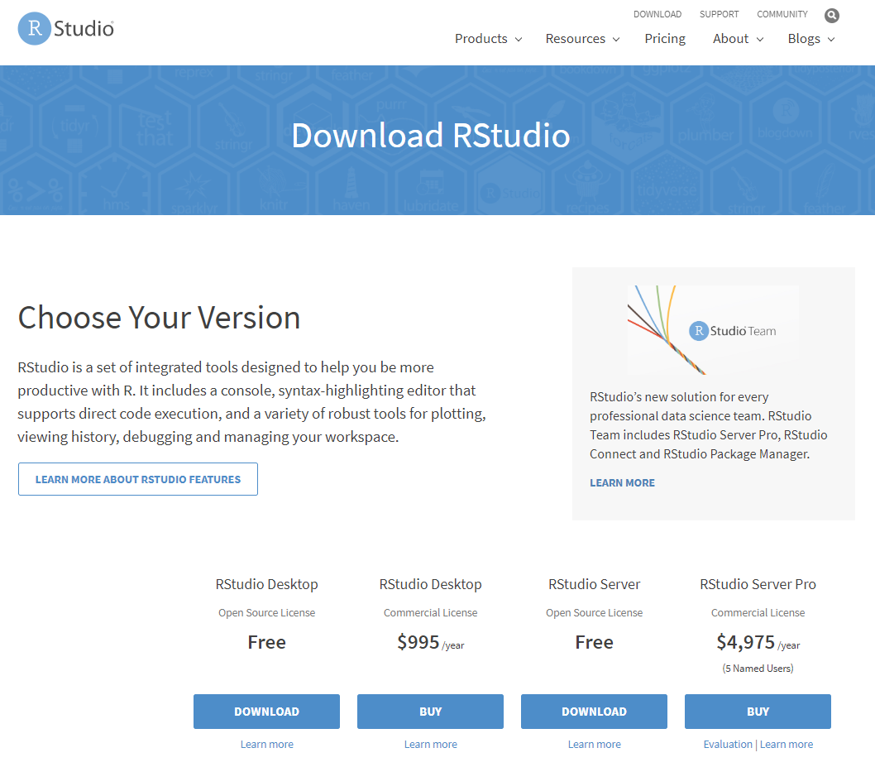
Installing R STUDIO
Select “Download” in the “Free” column

Slide 15
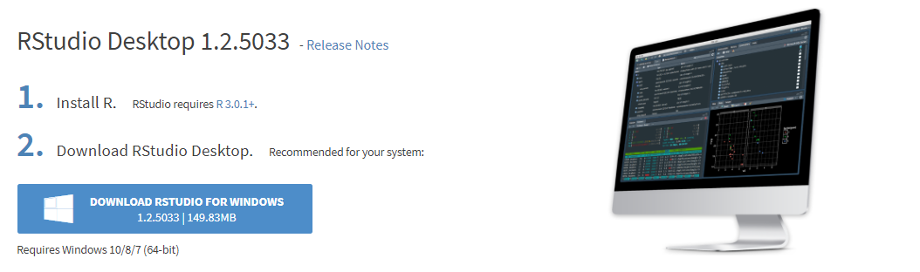
Installing R STUDIO
Click the download button

Slide 16
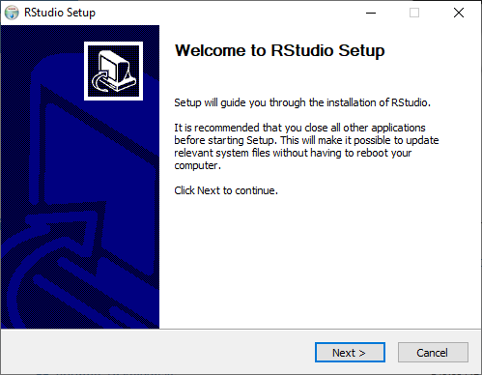
Installing R STUDIO
Proceed through the installer. (I recommend making a desktop shortcut)

Slide 17
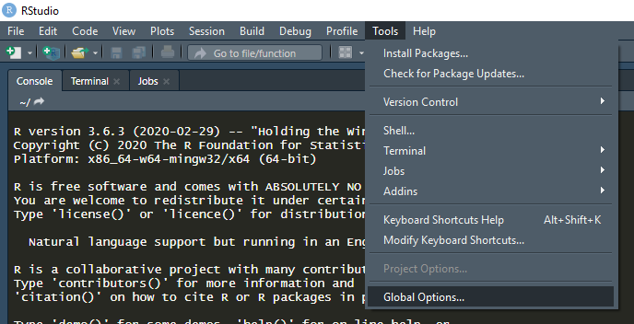
Optional Tweaks
Can get started using RStudio as-is, but there are small options I suggest changing for quality of life
Open RStudio, select the Tools drop-down menu at the top, then click “Global Options”

Slide 18
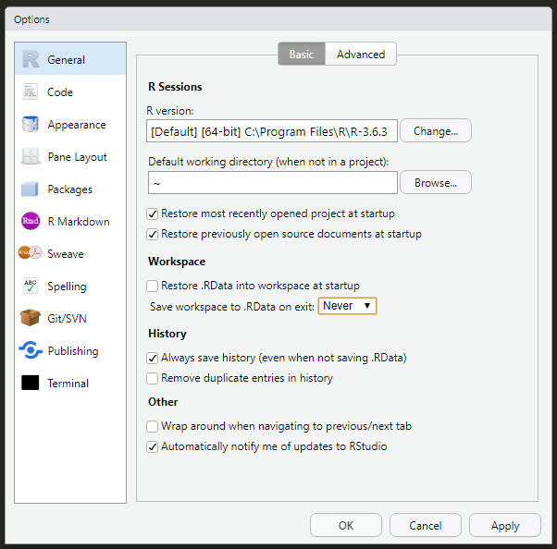
Optional Tweaks
Fresh Start:
In “General” tab (on left)
Deselect: “Restore .RData into workspace at startup”
Change “Save workspace to .RData on exit:” to “Never”
Ensures RStudio is ready for anything when you open it

Slide 19
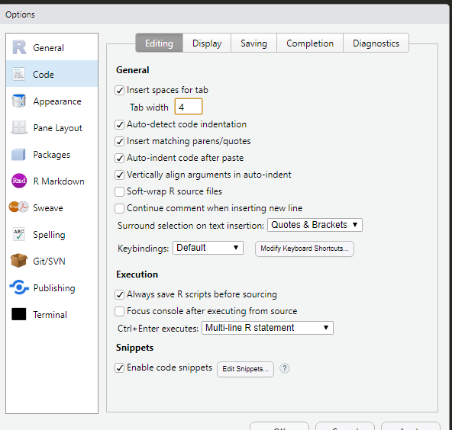
Optional Tweaks
Code tab on left
Change tab width to 4
Easier to differentiate indentation

Slide 20
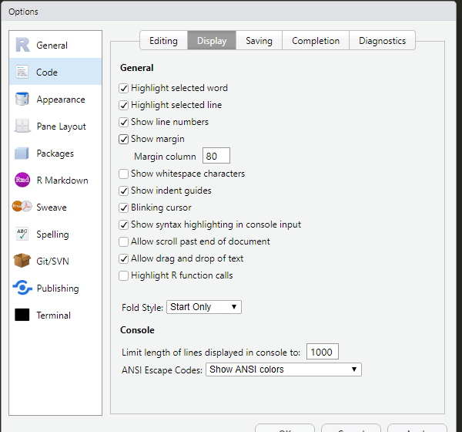
Optional Tweaks
Code tab on left
In “Display” tab at top, enable:
“Highlight selected line”
“Show margin”
“Show syntax highlighting in console input”
Easier to read and navigate code

Slide 21
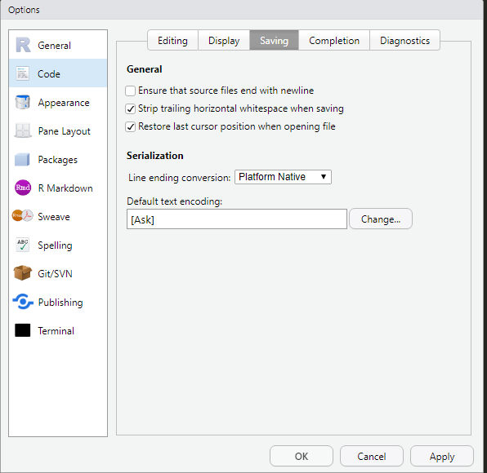
Optional Tweaks
Code tab on left
In “Saving” tab at top, enable:
“Strip trailing horizontal whitespace when saving”
Removes unnecessary spaces at end of line. Best practice

Slide 22
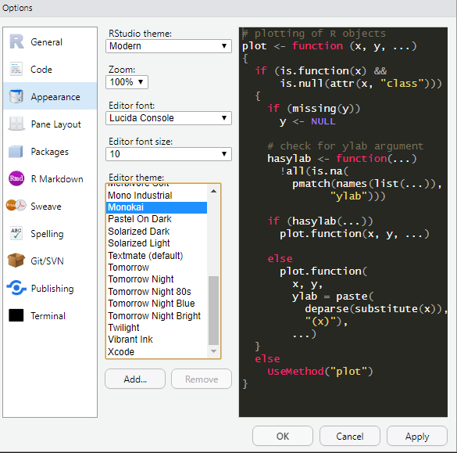
Optional Tweaks
Appearance tab on left
Play with theme, zoom, font, size, and theme to suit your preferences
I tend toward dark themes with high contrast/legible fonts
Personal favorite editor themes:
Monokai and Tomorrow Night Bright

Slide 23
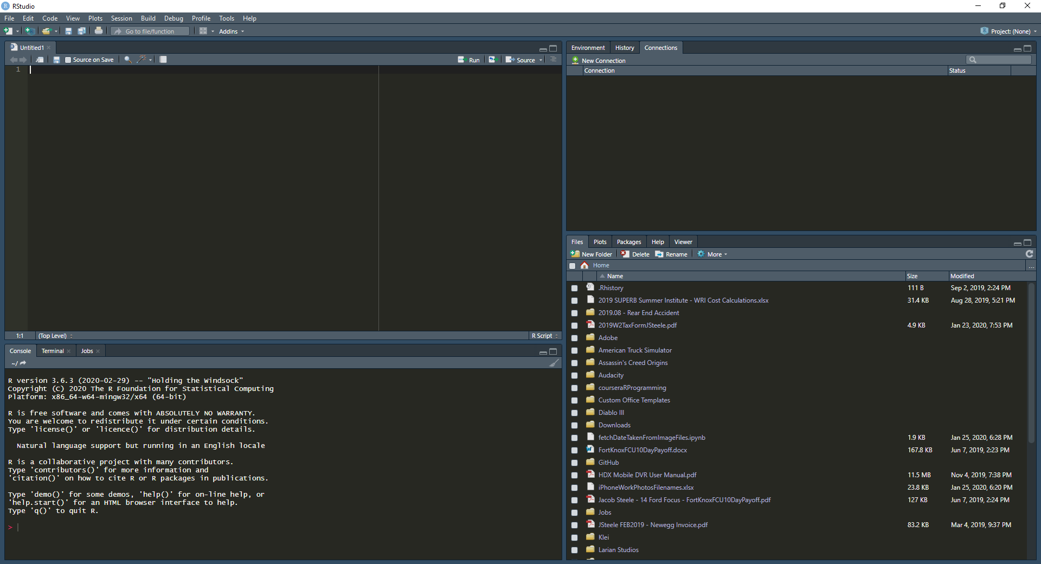
Navigating Rstudio: The four Panels
RStudio typically broken up into four panels: Upper left/right and lower left/right
I’ll refer to these as UL/UR and LL/LR accordingly
Want to give general overview of each panel and its purpose
A couple of tabs not used much by beginners, but good to be familiar
UR
UL
LR
LL

Slide 24
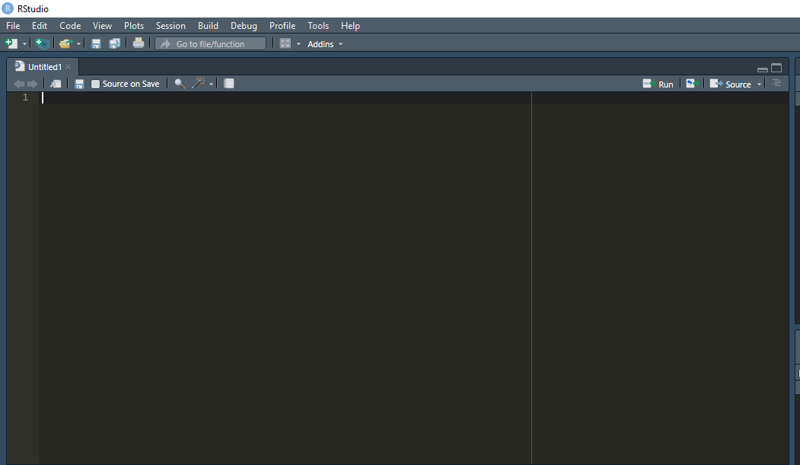
Navigating RStudio
UL: Script Editor
For writing scripts you want to run in R
Take multiple steps at once, in a repeatable fashion
Vs telling R to do each step one-by-one

Slide 25
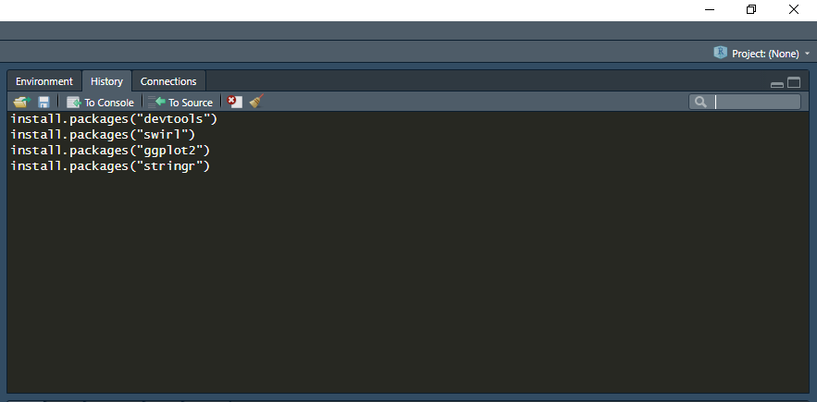
Navigating RStudio
UR: Environment & History
Environment shows current variables
i.e. for data tables, can see dimensions or preview contents
History is list of commands submitted
Useful for troubleshooting

Slide 26
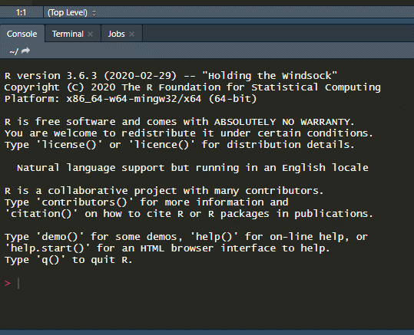
Navigating RStudio
LL: Console, Terminal, Jobs
Console is where R lives.
Commands can be entered directly.
Output & interaction can also take place here.

Slide 27
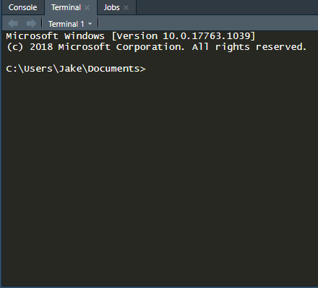
Navigating RStudio
LL: Console, Terminal, Jobs
Terminal is similar to command prompt/system shell.
Too much to cover in-depth
Be aware you can enter terminal commands here.

Slide 28
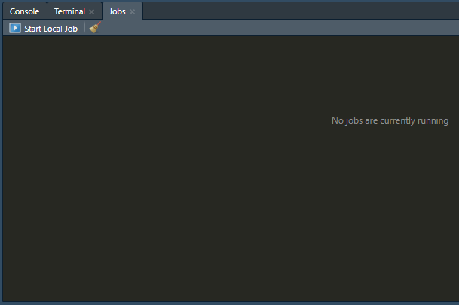
Navigating RStudio
LL: Console, Terminal, Jobs
Jobs is similarly “high-level”
When you tell R to do something, that task is sent here
Not much to interact with starting out, but if your script seems to be taking a while to run, you can check status here.
Learn more on the RStudio Blog

Slide 29
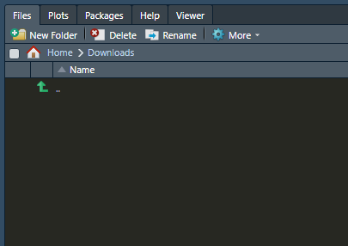
Navigating RStudio
LR: Files, Plots, Packages, Help, Viewer
Files is a file browser.
Like opening folders on your computer
Useful for navigating around to find data files or opening different scripts

Slide 30
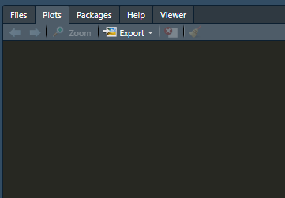
Navigating RStudio
LR: Files, Plots, Packages, Help, Viewer
Plots shows any plots made in current session
Can cycle through using arrows, or export plots for later use

Slide 31
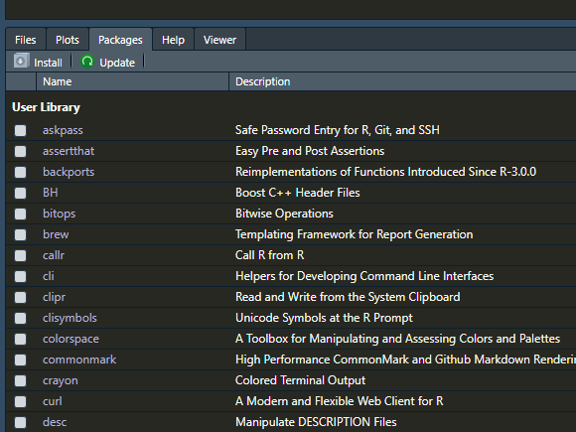
Navigating RStudio
LR: Files, Plots, Packages, Help, Viewer
Packages is a list of all installed “packages”
Packages are tools that you can use to expand base functionality of R

Slide 32
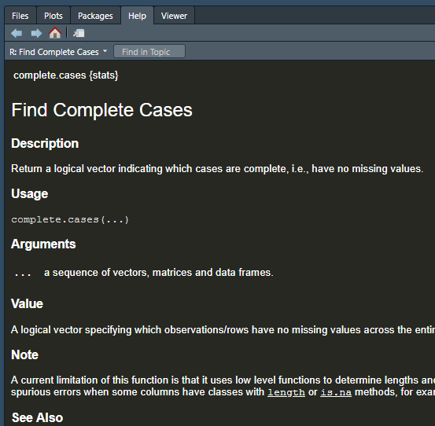
Navigating RStudio
LR: Files, Plots, Packages, Help, Viewer
Help is a built-in helper
Similar to something like a wiki page
Will show info about functions/etc, such as expected arguments or output

Slide 33
Using R As a Beginner
Use R as a calculator! Even if other methods might be more efficient, the practice can be invaluable.
Scientific calculations: C₁V₁ = C₂V₂, how much buffer you need for an expmt, etc…
Think through calculations by storing values in variables, write small functions to repeat calculations, etc.
volPerWell * wellsPerPlate * numPlates = total buffer
Define variables c1, c2, and v2. Now, you can find v1/volume to add by running: v1 = (c2 * v2) / c1

Slide 34
Using R As a Beginner
When you’re more comfortable…
Clean or analyze your data! Very helpful for larger data sets or repetitive tasks.
Move on to making graphs for presentations, posters, or publications! Very customizable.
Learn new packages that might be helpful for you.
Recommended: Pandas, ggplot2, tidyverse

Slide 35
Learning Resources
GOOGLE.
If you ever think “I wonder if R can…” GOOGLE IT.
Usually somebody has wondered same thing before, encountered a similar problem, etc.
“How to read data from an Excel spreadsheet into R”
“How to make dates in [format] recognized by [package] in R”
“How to split a full name into two columns in R dataframe”

Slide 36
Learning Resources
Swirl – “Learn R, in R”
A package in R that is meant to be run in RStudio
Meant to teach you about using R by practicing in RStudio
Very nice to help you get familiar with the interface
Intro to swirl here: https://swirlstats.com/students.html

Slide 37
Learning Resources
YouTube
For visual learners, there are lots of videos/tutorials out there, spanning the gamut of usecases or fields
Can also find many practice projects to get more comfortable using R

Slide 38
Learning Resources
Coursera
Lots of different R courses w/ video lectures from renowned universities
Suggests/promotes paid option/subscription
Offers “verified completion certificates,” however AUDITING COURSES IS FREE
Info on free course auditing here
Beginner course on R Programming (Johns Hopkins)

Slide 39
Learning Resources
Textbooks
Many available online, for free
Google “free ebook for R programming”
https://r4ds.had.co.nz
Others may be available in the library, or by interlibrary loan, etc.

Slide 40
Learning Resources
Package Documentation
Each package typically maintains their own documentation for functions used in the package etc
If there’s a function you’re new to or confused about, try looking it up in the official documentation
Typically descriptions of expected arguments and outputs, sometimes examples of use, etc.

Slide 41
Learning Resources
StackExchange/Online Forums/Documentation
StackExchange is a big resource for people across many topics such as Math, Stats, Sciences, Programming…
Essentially a Q&A forum with many experts available to answer questions
If you’re feeling stuck, ask a question!
But be sure to read the posting rules/guidelines first

Slide 42
Conclusions
R can be an exceptional tool to scientists at any point in their career
Wrangling your data, making publication-ready graphs, preparing for the job market, etc.
Don’t be scared off by being unfamiliar!
Once you get the hang of things, it will be easy to keep building your skills
Be sure to check out other talks from R Users Group and network with other users

Slide 43
THANK YOU!
Thank you for your time!
Thank you to the R Users Group for helping build the community.
Much of the installation content was based on this post:
http://derekogle.com/IFAR/supplements/installations/InstallRStudioWin.html

Slide 44
Questions?

